Slide 1
Lecture
Tables

Slide 2
Introducing Tables
Tables divide space into smaller cells… kind of like Microsoft Excel.
Tables, Rows, and Cells can all have their own styles:
  alignment
  height/width
  border width and color

Slide 3
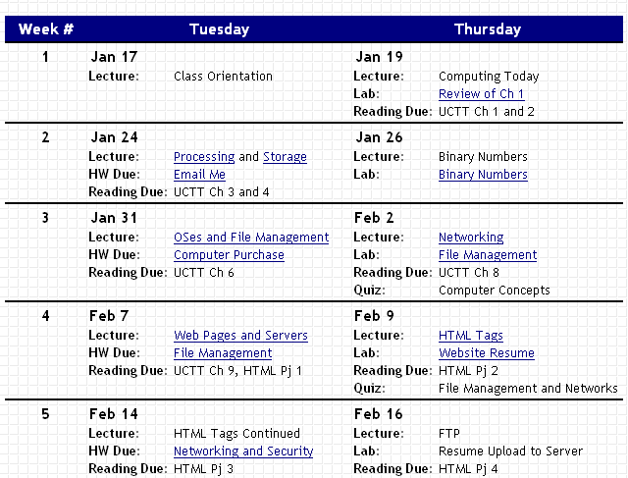
Table Sample
table
table row
table data

Slide 4
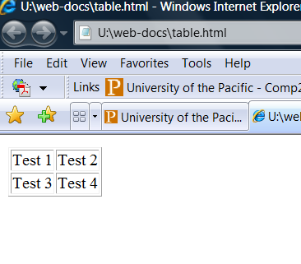
Table Tags
<table border=“1”>
<tr>
<td> Test 1 </td>
<td> Test 2 </td>
</tr>
<tr>
<td> Test 3 </td>
<td> Test 4 </td>
</tr>
</table>
**<tr> = table row ; <td> = table data

Slide 5
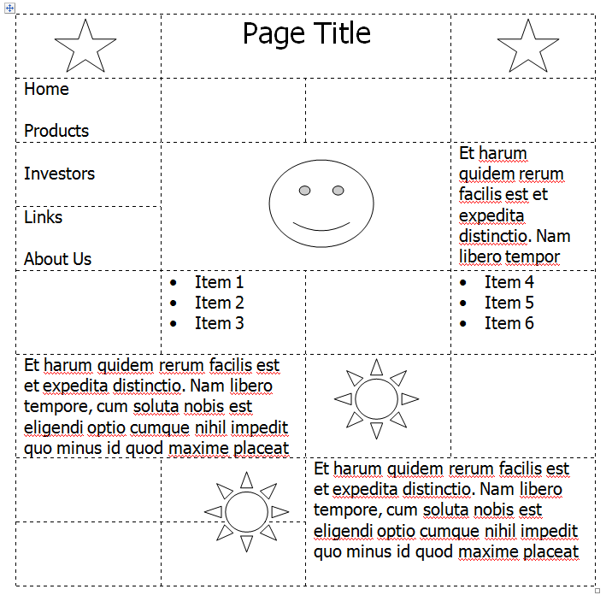
Using Tables for Page Layout

Slide 6
Header Cells
<th> = table header
Just like <td> tags but can be styled to look different
Both <td> and <th> are recognized as separate elements on style sheet
Use at the top of a table to explain what the column is for
Optional

Slide 7
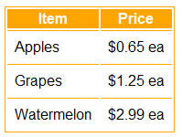
Tables with Information
<table>
<tr>
<th>Item</th>
<th>Price</th>
</tr>
<tr>
<td>Apples</td>
<td>$0.65 ea</td>
</tr>
...
<tr>
<td>Watermelon</td>
<td>$2.99 ea</td>
</tr>
</table>

Slide 8
Inline Table Attributes
<table border=“2”> Creates 2 pixel border
<table width=“100%”> Table spans 100% of page
<table align=“center”>
Use together!
<table width=“80%” border=“3” align=“center”>
<td width="40%"> Controls width of cells

Slide 9
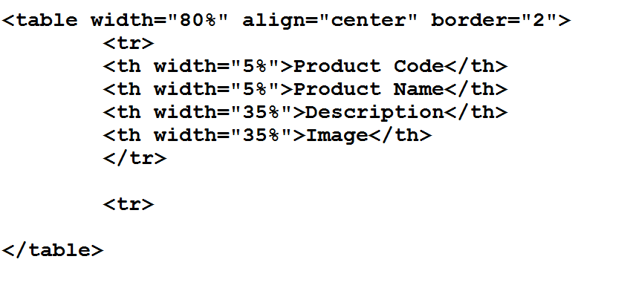
Inline Attributes in Action

Slide 10
Tables and Styles
Styles can control the appearance of tables, rows, and cells:
table {
background-color: blue;
border: 5px yellow solid;
}

Slide 11
Tables and Styles
table th{
background-color: red;
color: white;
font-family: 'Comic Sans MS';
}
td { vertical-align: top;
border: separate;}
http://www.w3.org/TR/CSS2/tables.html
Inline Style: <td valign=“top”> - not supported soon
Possible Values:
Separate (table, td = 2)
Collapse (table + td = 1)

Slide 12
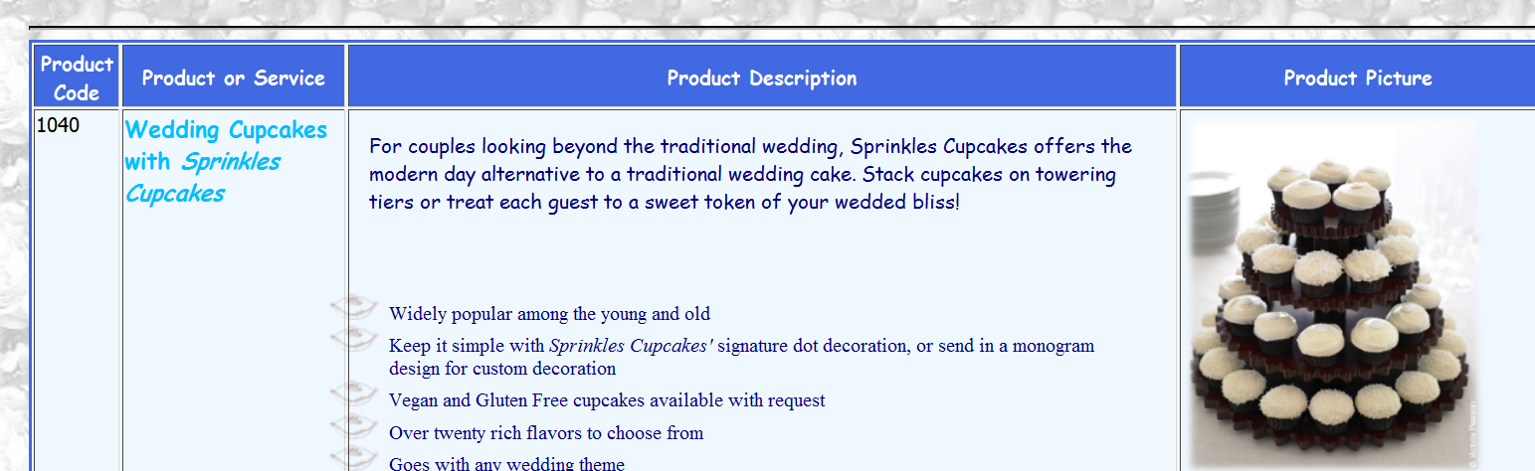
Tables and Styles
Data cells are aligned at the top
Tables have background color if the background is busy
All table elements stylized

Slide 13
Website Authoring/Editing Tools
Software can allow you to utilize a design interface
The software records the HTML/CSS as you design
Popular options include Adobe Dreamweaver and Microsoft Web Expression (changing)
Free options include Nvu

Slide 14
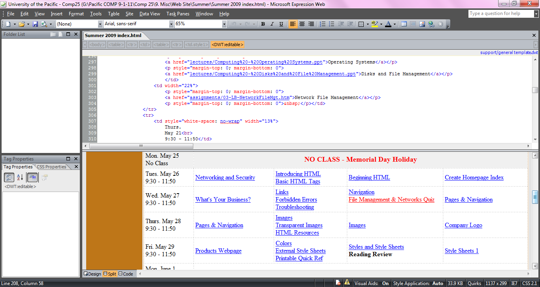
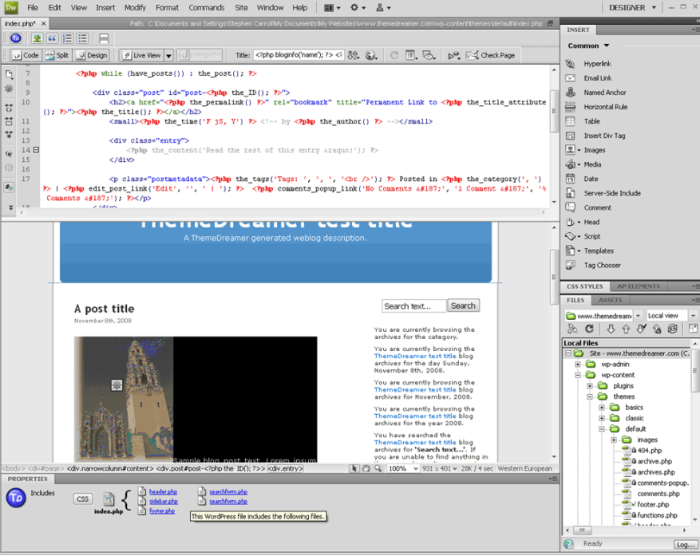
Software

Slide 15
Why Learn HTML/CSS
Difficult to understand advanced software unless we understand the logical programming it utilizes
Find flaws in a site designed by employee or contractor
Never be incapable of understanding, designing and updating a website
  not dependent on software
  you know the programming language (syntax and logical structure)

Slide 16
Google Analytics
Part of Google’s Cloud
Tools that allow you to track traffic to and from your website
Learn, evaluate and analyze in order to capitalize as business owner
  How many visitors
  Where are they located
http://www.google.com/analytics/

Slide 17
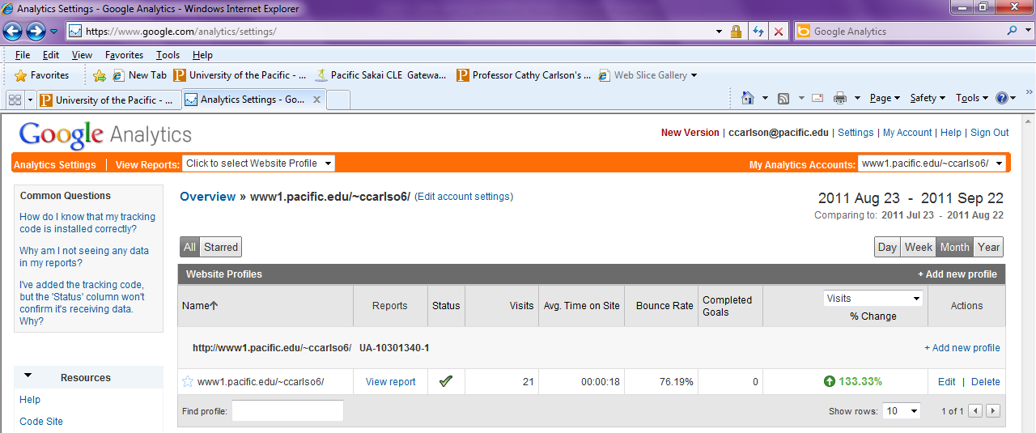
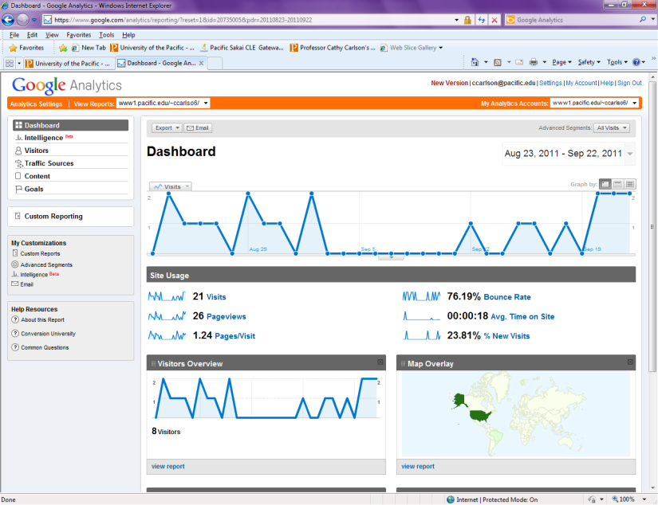
Sample

